Slide 1
Problem solving with estimation and rounding
Estimation and rounding

Slide 2
how to use Oak lessons

Slide 3
I can use my knowledge of estimation and rounding to solve problems.

Slide 4
A quick estimate for a calculation is obtained from using approximate values, often rounded to 1 significant figure.
When showing estimations we use to identify that the calculations are approximately the same but not equal.
For example,

Slide 5

Problem solving with estimation and rounding
Problem solving with estimation
Problem solving with error intervals
Using Fermi estimation

Slide 6
Problem solving with estimation
A quick estimate for a calculation is obtained from using approximate values, often rounded to 1 significant figure.
When we estimate, it is not required to be exact, but why do we estimate?
To make it easier and quicker to do calculations where the answer is very close to the actual answer.
Identifying the strategy first and then completing the calculation breaks the problem solving question into chunks.

Slide 7

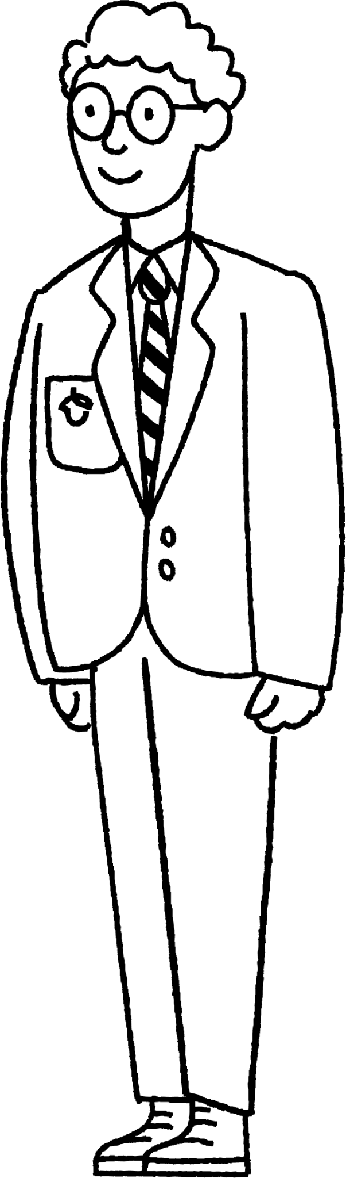
Problem solving with estimation
The height of the Statue of Liberty is 62 times the height of an average secondary school pupil.
How would you go about estimating the height of the Statue of Liberty?

Slide 8
Problem solving with estimation
The height of the Statue of Liberty is 62 times the height of an average secondary school pupil.
How would you go about estimating the height of the Statue of Liberty?
Estimate the average height of a secondary school pupil × 60

Slide 9
Problem solving with estimation
The height of the Statue of Liberty is 62 times the height of an average secondary school pupil.
How would you go about estimating the height of the Statue of Liberty?
Statue of Liberty is
93 m high
Firstly, round as we are estimating.
Average height pupil 1.5 m
Statue of Liberty 1.5 × 60
Statue of Liberty 90 m

Slide 10
Problem solving with estimation
Here is a rectangle with a 3.78 cm length square removed. The shaded area is 198.7 cm². Work out an estimate for the missing length.
Firstly, round as we are estimating.
4 cm
Area of rectangle - area of square 200 cm²
9.86 cm
4 cm
10 cm
Area of the square 4 × 4 = 16 cm²
10 × length - 16 200 cm²
………… cm
10 × length 216 cm²
length 21.6 cm

Slide 11
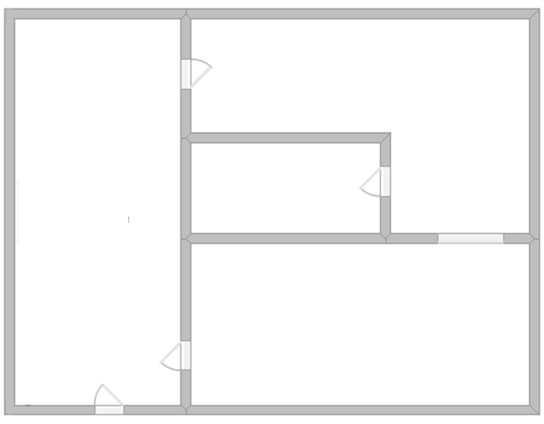
Problem solving with estimation
1) Here is a scaled drawing of a ground floor house. Given the dimensions, can you work out an estimate for the missing dimensions? Show your working out.
34.68 m²
…… m
33.62 m²
……… m²
32.32 m²
13.83 m

Slide 12
Problem solving with estimation
1) Here is a scaled drawing of a ground floor house. Given the dimensions, can you work out an estimate for the missing dimensions? Show your working out.
Lots of different ways you could have worked this out.
Start with rounding appropriately.
34.68 m²
…… m
33.62 m²
……. m²
32.32 m²
13.83 m

Slide 13
Problem solving with estimation
1) Here is a scaled drawing of a ground floor house. Given the dimensions, can you work out an estimate for the missing dimensions? Show your working out.
Here we have rounded each number to the nearest 5.
35 m²
…… m
35 m²
……. m²
30 m²
15 m

Slide 14
Problem solving with estimation
1) Here is a scaled drawing of a ground floor house. Given the dimensions, can you work out an estimate for the missing dimensions? Show your working out.
Given the diagram is to scale, the 15 m can be approximately divided into the ratio of 1 : 2 so we have 5 m and 10 m.
35 m²
…… m
35 m²
……. m²
30 m²
5 m
10 m

Slide 15
Problem solving with estimation
1) Here is a scaled drawing of a ground floor house. Given the dimensions, can you work out an estimate for the missing dimensions? Show your working out.
Therefore to make the 30 m².
35 m²
35 m²
……. m²
….. m
30 m²
5 m
10 m

Slide 16
Problem solving with estimation
1) Here is a scaled drawing of a ground floor house. Given the dimensions, can you work out an estimate for the missing dimensions? Show your working out.
Therefore to make the 30 m²
we know this length should be approximately 3 m.
35 m²
35 m²
……. m²
3 m
30 m²
5 m
10 m

Slide 17
Problem solving with estimation
1) Here is a scaled drawing of a ground floor house. Given the dimensions, can you work out an estimate for the missing dimensions? Show your working out.
This length should be slightly greater than 3 because we have 35 m². A good estimate would be 4 m.
35 m²
4 m
35 m²
……. m²
3 m
30 m²
5 m
10 m

Slide 18
Problem solving with estimation
1) Here is a scaled drawing of a ground floor house. Given the dimensions, can you work out an estimate for the missing dimensions? Show your working out.
This area is then expected to be 40 m².
35 m²
4 m
35 m²
.….. m²
3 m
30 m²
5 m
10 m

Slide 19
Problem solving with estimation
1) Here is a scaled drawing of a ground floor house. Given the dimensions, can you work out an estimate for the missing dimensions? Show your working out.
So the missing area is approximately 5 m².
35 m²
4 m
35 m²
5 m²
3 m
30 m²
5 m
10 m

Slide 20
Problem solving with estimation
1) Here is a scaled drawing of a ground floor house. Given the dimensions, can you work out an estimate for the missing dimensions? Show your working out.
Lots of different ways you could have worked this out.
Anything between 6m and 10 m is acceptable
Anything between 4 m² and 8 m² is acceptable.
34.68 m²
Approximately 7 m
Approx
5 m²
33.62 m²
32.32 m²
13.83 m

Slide 21
Problem solving with estimation and rounding
Problem solving with estimation
Problem solving with error intervals
Using Fermi estimation

Slide 22
Problem solving with error intervals
We use error intervals to help us calculate the largest and smallest values of a calculation.
The error interval has a lower and upper limit.
a ≤ x < b
Where a represents the lower limit of the error interval and b represents the upper limit of the error interval.
However, it is important to know which limits from our error intervals to use in order to calculate the largest and smallest values.

Slide 23
Problem solving with error intervals
For example, (addition) during a summer day, the temperature was 12.4 ℃ (to 1 d.p.) and increased by 6.8 ℃ (to 1 d.p.). What is the error interval for the new temperature?
Working out the error intervals we have:
12.35 ≤ original < 12.45 and 6.75 ≤ increase < 6.85
How do we work out the error interval using addition?

Slide 24
Problem solving with error intervals
For example, (addition) during a summer day, the temperature was 12.4 ℃ (to 1 d.p.) and increased by 6.8 ℃ (to 1 d.p.). What is the error interval for the new temperature?
Working out the error intervals we have:
12.35 ≤ o < 12.45 and 6.75 ≤ i < 6.85
Error interval for the new temperature
Sum of lower limits
19.1 ≤ n < 19.3
Sum of upper limits
19.1 ≤ n

Slide 25
Problem solving with error intervals
For example, (multiplication) a square has lengths 8.2 m measured to 1 decimal place. Work out the error interval for the area of the square.
Working out the error intervals we have:
8.15 ≤ l < 8.25
How do we work out the error interval using multiplication?

Slide 26
Problem solving with error intervals
For example, (multiplication) a square has lengths 8.2 m measured to 1 decimal place. Work out the error interval for the area of the square.
Working out the error intervals we have:
8.15 ≤ l < 8.25
Error interval for the area of the square:
8.15² ≤ a < 8.25²
66.4225 ≤ a < 68.0625
Productof lower limits
Product of upper limits

Slide 27
Problem solving with error intervals
For example, (subtraction) a piece of string was 12 cm measured to the nearest cm. A length of 9.7 cm (to 1 d.p.) was cut off. What is the error interval for the remaining length?
Working out the error intervals we have:
11.5 ≤ l < 12.5 and 9.65 ≤ c < 9.75
How do we work out the error interval using subtraction?

Slide 28
Problem solving with error intervals
For example, (subtraction) a piece of string was 12 cm measured to the nearest cm. A length of 9.7 cm (to 1 d.p.) was cut off. What is the error interval for the remaining length?
Working out the error intervals we have:
11.5 ≤ l < 12.5 and 9.65 ≤ c < 9.75
Error interval for the remaining length:
The lower limit is the lower limit of l subtract upper limit of c
11.5 − 9.75 < r < 12.5 − 9.65
The upper limit is the upper limit of l subtract lower limit of c
1.75 < r < 2.85

Slide 29
Problem solving with error intervals
Understanding how to use the limits or error intervals allows multi step problem solving to be easier.
Here is a triangle with given lengths 6.5 cm (to 1 d.p.), 8.2 cm (to 1 d.p.) and a perimeter of 16.4 cm (to 1 d.p.). Find the error interval of the unknown length.
What is the first step before applying any calculations?
6.5 cm (to 1 d.p.)
8.2 cm (to 1 d.p.)
Perimeter = 16.4 cm (to 1 d.p.)

Slide 30
Problem solving with error intervals
Find the error interval of each length.
6.45 ≤ a < 6.55
8.15 ≤ b < 8.25
16.35 ≤ p < 16.45
6.5 cm (to 1 d.p.)
8.2 cm (to 1 d.p.)
How do we work out the error interval of the missing length?
Perimeter = 16.4 cm (to 1 d.p.)

Slide 31
Problem solving with error intervals
Find the error interval of each length.
6.45 ≤ a < 6.55
8.15 ≤ b < 8.25
16.35 ≤ p < 16.45
6.5 cm (to 1 d.p.)
8.2 cm (to 1 d.p.)
Upper limit of the missing length:
Upper p − lowest a − lowest c
16.45 − 6.45 − 8.15 = 1.85

Slide 32
Problem solving with error intervals
Find the error interval of each length.
6.45 ≤ a < 6.55
8.15 ≤ b < 8.25
16.35 ≤ p < 16.45
6.5 cm (to 1 d.p.)
8.2 cm (to 1 d.p.)
Lower limit of the missing length:
Lower p − upper a − upper c
16.35 − 6.55 − 8.25 = 1.55
Error interval for the missing length is 1.55 < l < 1.85

Slide 33
Problem solving with error intervals
The area of a circle is given as 12 cm² (to 2 s.f.) and the length of the square is 2.8 cm² (to 1 d.p.). Work out the error interval of the area of the shaded.
Error interval for the area of a circle
11.5 ≤ a_{c} < 12.5
Error interval for the area of the square
2.75² ≤ a_{s} < 2.85²
7.5625 ≤ a_{s} < 8.1225
Error interval for shaded
11.5 - 8.1225 < s < 12.5 − 7.5625
3.3775 < s < 4.9375

Slide 34
Problem solving with error intervals
A rectangle has a square removed from the centre.
Work out the error interval for the shaded area.
0.8 cm (to 1 d.p.)
1.4 cm
(to 1 d.p.)
4 cm (to 1 s.f.)

Slide 35
Problem solving with error intervals
A rectangle has a square removed from the centre.
Work out the error interval for the shaded area.
Length of square : 0.75 ≤ l_{s} < 0.85
Area of square: 0.5625 ≤ a_{s} < 0.7225
0.8 cm (to 1 d.p)
1.4 cm
(to 1 d.p.)
Length of rectangle : 3.5 ≤ l_{r} < 4.5
Width of rectangle : 1.35 ≤ w < 1.45
4 cm (to 1 s.f.)
Area of rectangle:
3.5 × 1.35 ≤ a_{r} < 4.5 × 1.45
4.725 ≤ a_{r}< 6.525
Area of shaded:
4.725 − 0.7225 < shaded < 6.525 − 0.5625
4.0025 < shaded < 5.9625

Slide 36
Problem solving with estimation and rounding
Problem solving with estimation
Problem solving with error intervals
Using Fermi estimation

Slide 37




Using Fermi estimation
Have you ever been to a fair or event and there is a jar full of sweets and you win a prize if your guess is the closest to the actual number of sweets in the jar?
How did you make your guess? Was it random or did you have a strategy?

Slide 38

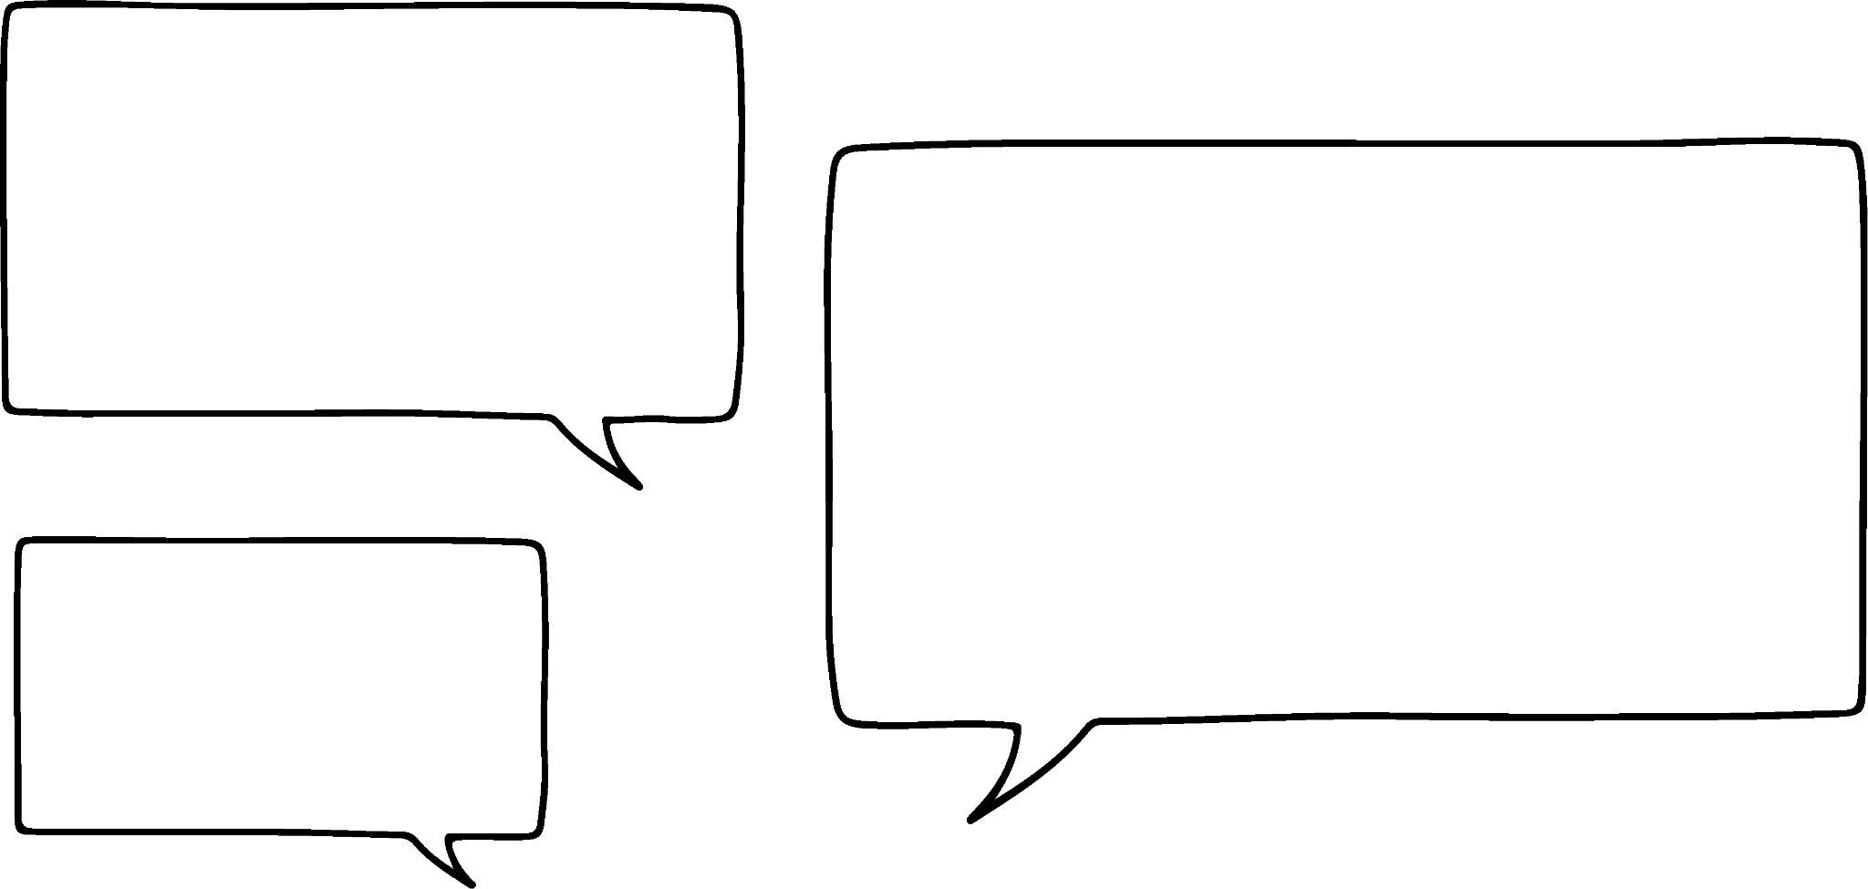


Using Fermi estimation
I love these types of things! I just guess.
Aisha
I love them too! I look at the bottom layer of sweets, count how many there are then multiply it by approximately how many layers there are.
Sam

Slide 39
Using Fermi estimation
I count about 5 sweets in the bottom layer.
There are about 9 layers, so I think there are around 45 sweets.
Sam

Slide 40
Using Fermi estimation
The method Sam uses is an approach used with Fermi problems.
I love them too! I look at the bottom layer of sweets, count how many there are then multiply it by approximately how many layers there are.
Sam

Slide 41
Using Fermi estimation
The method Sam uses is an approach used with Fermi problems. Sam needed some initial data or information first, in this case the first layer, then applied the relevant operation or structured working out. Fermi problems embrace a variety of strategies to estimate an answer.
Why are they called Fermi problems?
Sam

Slide 42

Using Fermi estimation
Enrico Fermi was an engineer and physicist born at the start of the 20th century. Born in Italy and later moved to America, he is renowned for being the creator of the world's first nuclear reactor. A Fermi estimation problem uses approximation to make calculations short and quick. These problems are named after Fermi as he was known for his ability to make good approximate calculations.

Slide 43
Using Fermi estimation
How many times does the average person’s heart beat in a lifetime? (You cannot use a calculator.)
Hint 1 - How can you find some data on heart beats minute?
If you don’t have this data to hand, why not count your own.
On average it is 60 beats per min.
This is then 60 × 60 = 3600 beats per hour.
Rounding 24 hours to 20, 3600 × 20 = 72 000 beats per day
Rounding 365 to 400, 72 000 × 400 = 28 800 000 beats per year
Average person lives 80 years
Approximately 30 000 000 × 80 = 2 400 000 000 beats per lifetime

Slide 44
Using Fermi estimation
1) How much rubbish in tonnes does the UK produce every year? (without a calculator)
Hint - If you don’t have data to hand, think about how much your household throws away each week.

Slide 45
Using Fermi estimation
2) How many pennies would it take to make a stack the height of the Statue of Liberty? (without a calculator)
Hint - If you don’t know the thickness of a penny, measure one.

Slide 46
Using Fermi estimation
3) How many tennis balls can fit into your bedroom?

Slide 47
Using Fermi estimation
1) How much rubbish in tonnes does the UK produce every year?
There are lots of ways to estimate this.
The average household produces 20 kg of rubbish per week.
Rounding 52 to 50, this is then 20 × 50 = 1000 kg of rubbish per year per household.
There are approximately 27 million households.
Rounding 27 to 30, this means 30 000 000 × 1000 = 30 000 000 000 kg
Converting to tonnes 30 000 000 000 ÷ 1000 = 30 000 000 tonnes

Slide 48
Using Fermi estimation
2) How many pennies would it take to make a stack the height of the Statue of Liberty? (without a calculator)
The thickness of a penny is 1.52 mm, so round this to 1.5 mm
The Statue of Liberty is 93 m high, so round this to 90 m
The calculation is 90 m ÷ 1.5 mm
So converting 90 m to mm we have 90 000 mm
The calculation is 90 000 mm ÷ 1.5 mm = 60 000 pennies

Slide 49
Using Fermi estimation
3) How many tennis balls can fit into your bedroom?
There are lots of different strategies to work this out and is pupil dependent.
Measuring the dimensions of the bedroom and given a tennis ball has a standard diameter of 6.85 cm, a pupil can work out an approximation of how many tennis balls are needed to fill their bedroom.

Slide 50
Problem solving with estimation and rounding
With any type of problem solving question, understanding the context of the problem allows a strategy to be formed. This can be said with estimating and error intervals. Knowing how to find the error interval and apply those limits correctly to calculations allows maximum and minimum values to be determined.
Fermi’s problems are fantastic problems as they allow you to make reasonable estimates about a situation so to determine an approximate answer.

Slide 51

© Oak National Academy 2024.
Produced in partnership with Mathematics in Education and Industry.
Licensed on the Open Government Licence v3.0, except where otherwise stated. See Oak terms and conditions.

